Slide 1
Predicting across all US households
http://faraday.io Seamus Abshere, CTO

Slide 2
My talk
What does it take to create an AI startup?
Tips & tricks
Concerns for the future

Slide 3
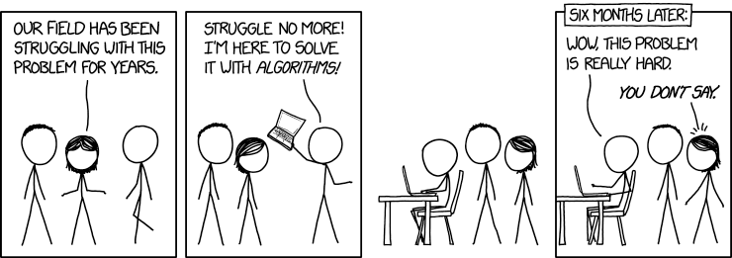
The beginning of Faraday

Slide 4
Our new AI startup in 2013
Problem: who are good customers for home remodeling?
First customer: biggest contractor in Massachusetts
Notes:
$100 million per year…. Larry, MIT signal engineer, loved asking for charts we’d never heard of

Slide 5
Our new AI startup in 2013
Manually buying and cleaning data via fax (!)
Support vector machines 💥 exploding
Servers melting
Deadline today…

Slide 6
What does it take to be an AI startup?
Tool experts? (fix the SVM, unmelt servers)
or
Domain experts? (focus on data and signal)

Slide 7
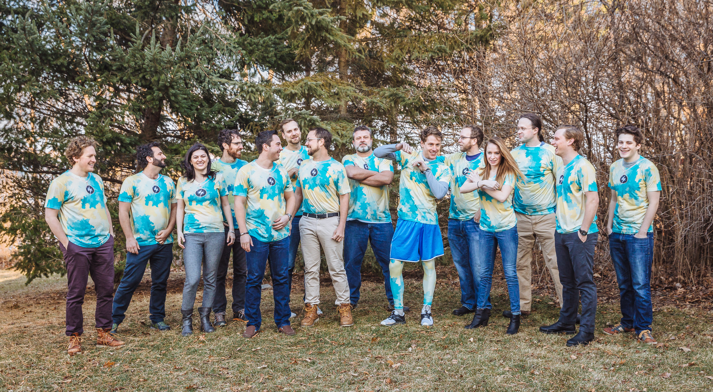
Here we are in 2017

Slide 8
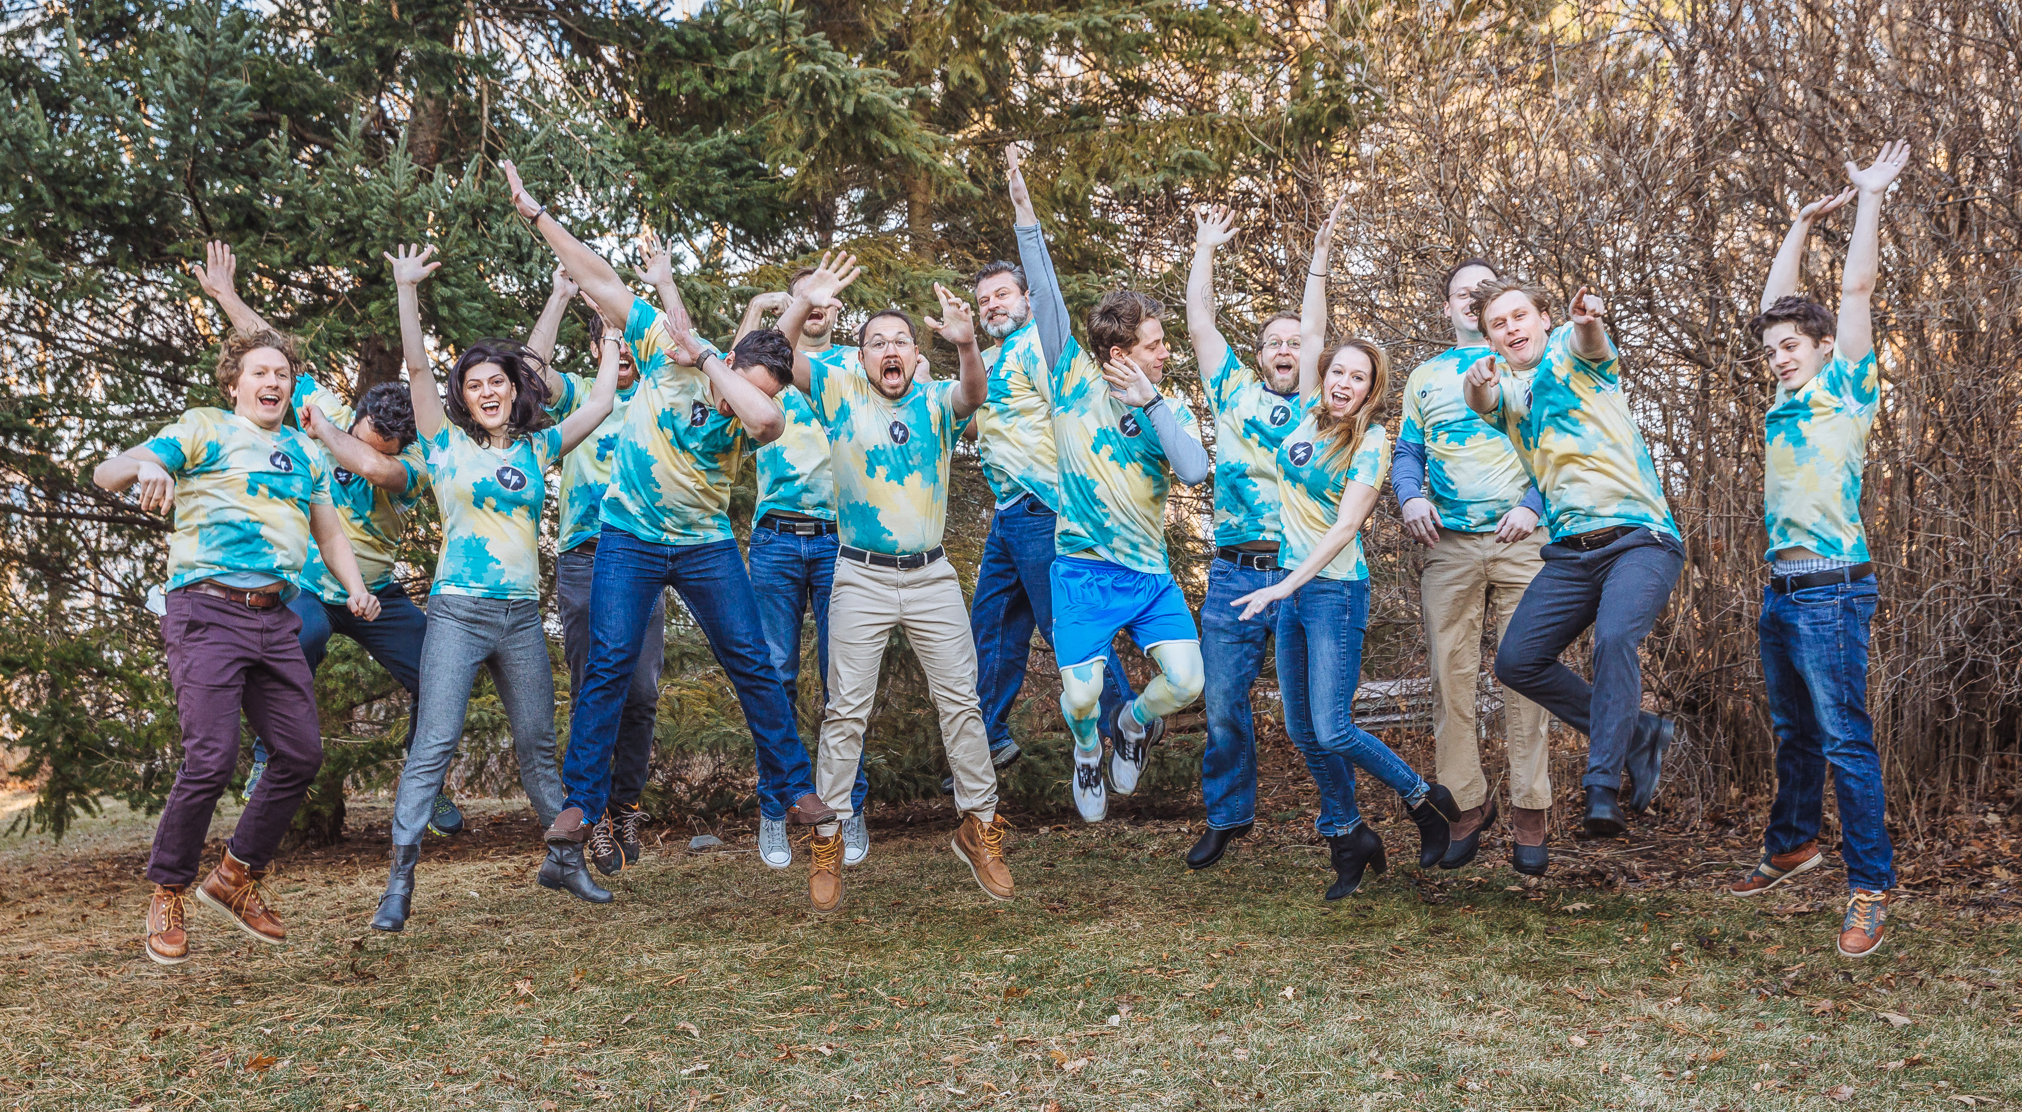
Here we are in 2017

Slide 9
What we did
Bought databases of all US customers
500+ million records
250+ columns
Outsourced AI tools

Slide 10
What have we learned?
Clean data first
Geocode everything
Use a good database
Join data
Choose algorithm
Scale algorithm
Labels are secret sauce
Report correctly
Watch for cheating
Automate workflow
Notes:
You can’t possibly

Slide 11
Clean data first
How do I remove garbage?
Do it before anything else
“More expensive data is, the s***** it is”

Slide 12
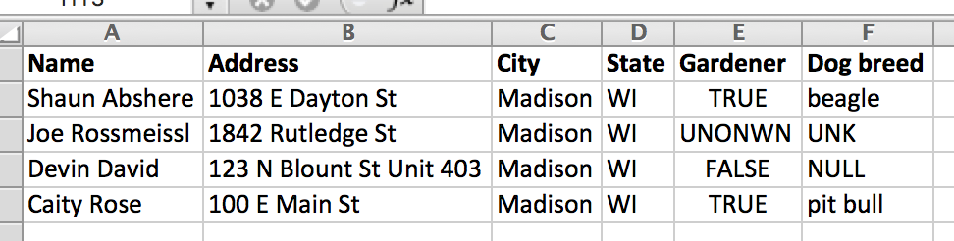
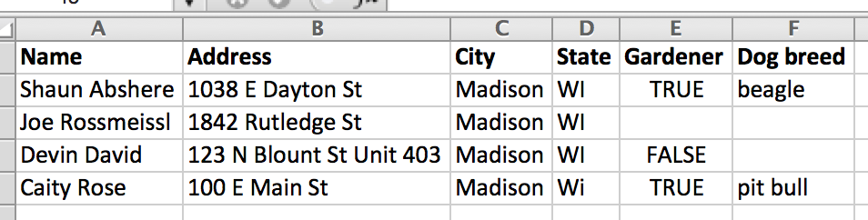
Clean data first
https://github.com/faradayio/scrubcsv Fixes formatting and removes nulls at 100mb/s

Slide 13
Geocode everything
How do I compare data from multiple sources?
Need a single source of truth
Notes:
The more expensive a dataset, the crappier it is. Google is expensive, smartystreets is unlimited

Slide 14
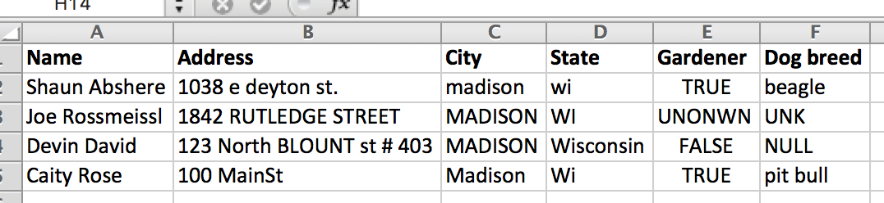
Geocode everything
https://www.npmjs.com/package/smartystreets 3000 records/second - $1000/mo unlimited

Slide 15
Use a good database
How do I query my data?
Start simple but powerful

Slide 16

Use a good database
Try Postgres
Best fuzzy matching
Best CSV import/export
Best user-defined functions
Best NoSQL support
ironic
Best of all: 🎉 SQL 🎉

Slide 17
Join data
How do I make a single database out of many?
Fuzzy and exact matching with fallbacks

Slide 18
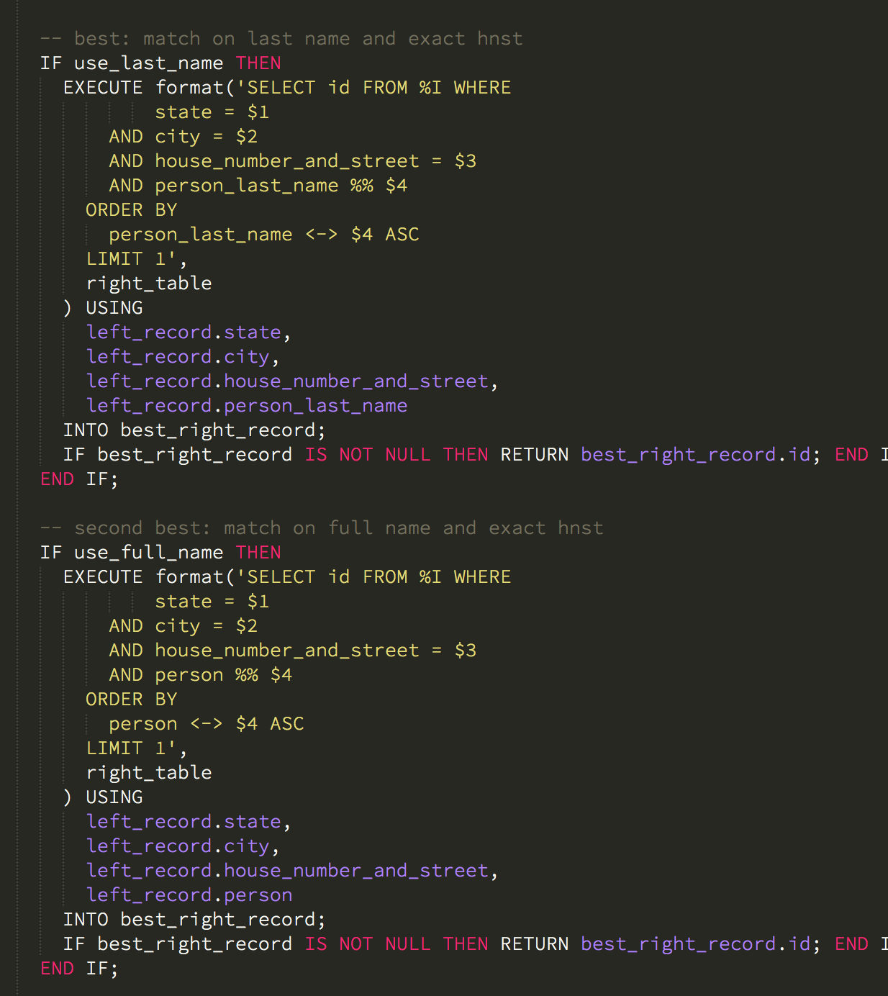
Join data
Start with exact matches – these are best
Fall back to fuzzy
N-gram similarity is better than alternatives
Spatial matching (lat/lon) is slow
https://www.postgresql.org/docs/9.6/static/pgtrgm.html

Slide 19
Choose algorithm
How do I find a signal?
Lots of confusing options
SVM (slow, lots of memory)
Decision trees (fast, simple)
Neural nets (powerful, complex)

Slide 20
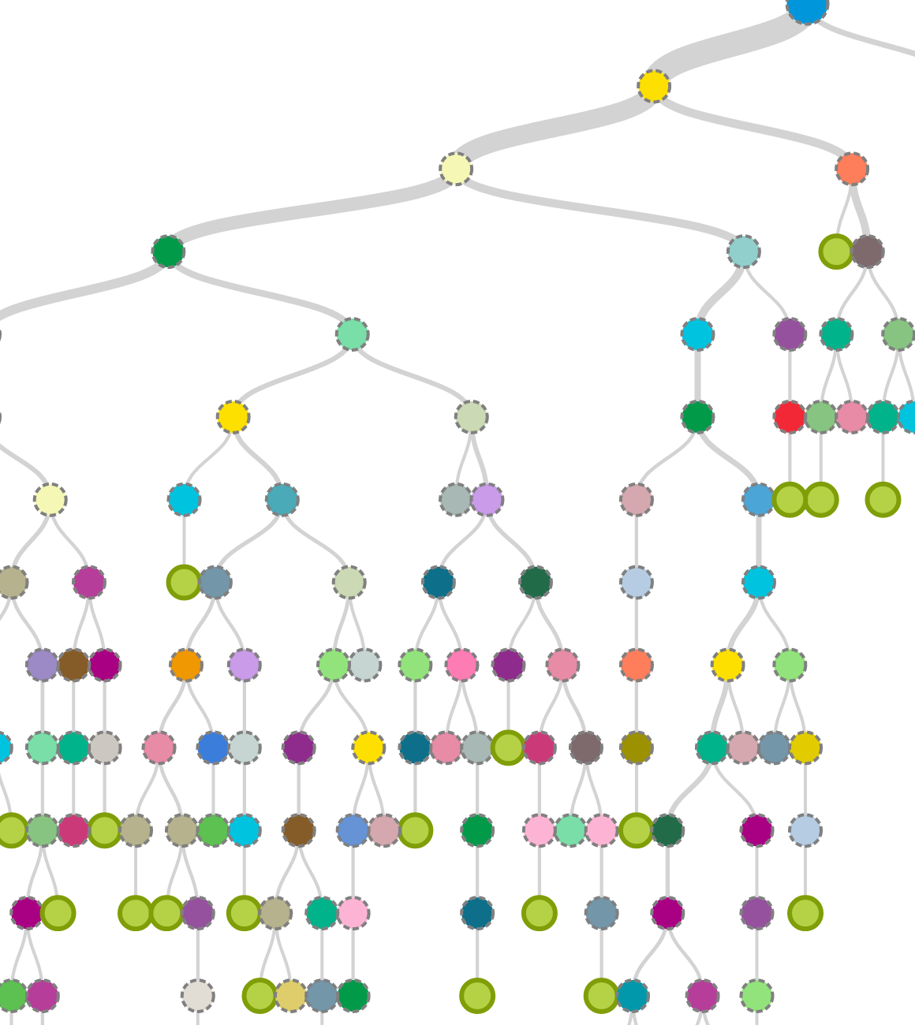
Choose algorithm
Decision trees are a good default
Resistant to overfitting
Fast
Notes:
Tooling gets better every day, you could use all your energy just keeping up. Focus on your area of expertise!

Slide 21
Scale algorithm
How do I make predictions across millions of rows?

Slide 22
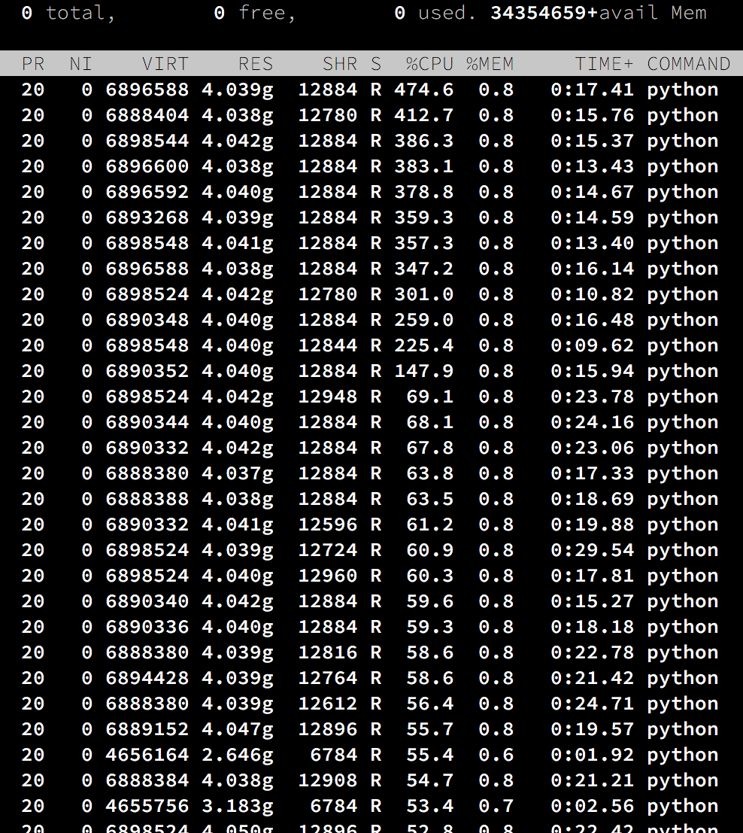
Scale algorithm
Buy big servers and parallelize everything
Or…
Algorithm-as-a-service
https://bigml.com/

Slide 23
Labels are secret sauce
What is interesting about your data?
Try classifying it in many ways

Slide 24
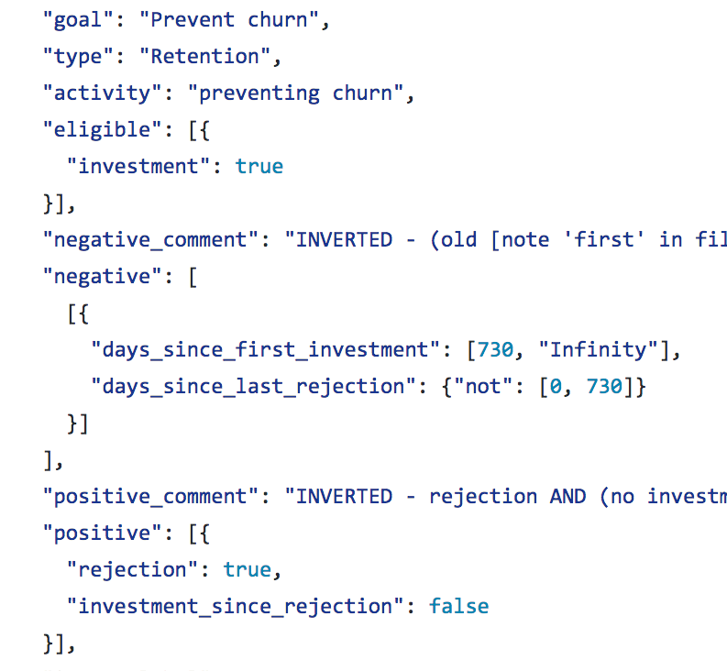
Labels are secret sauce
Simple
Made purchase = good
Don’t call me back = bad
More advanced
Per-client goals
Time- and sequence-based

Slide 25
Report correctly
How can I avoid embarrassing myself?
Don’t be fooled by 99% accuracy

Slide 26
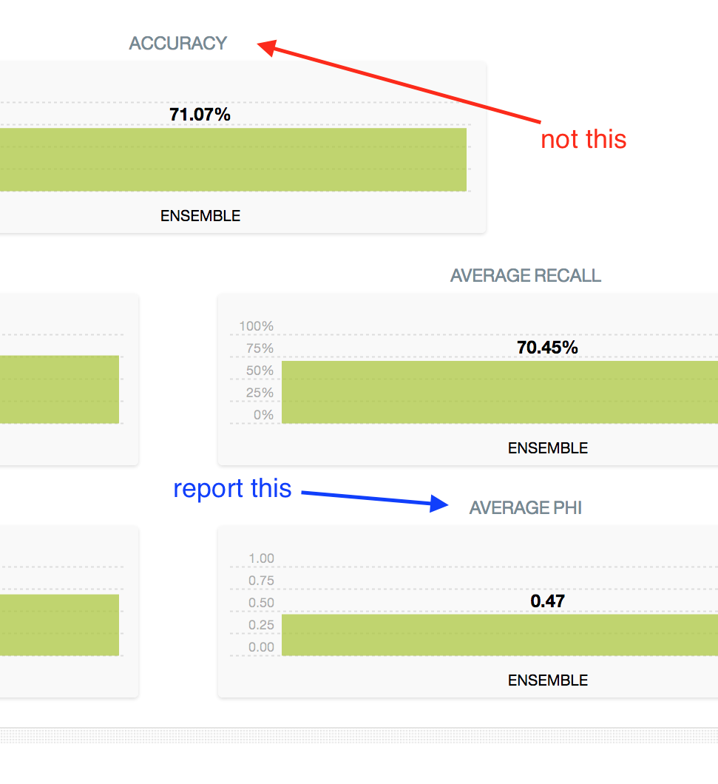
Report correctly
Before
Accidentally reported training as test 😳
Accuracy
After
Automated train/test
Phi
Class balancing
Notes:
Use metrics that tell you if you’re really finding a signal

Slide 27
Watch for cheating
How do I know if I found a signal?
Be paranoid

Slide 28
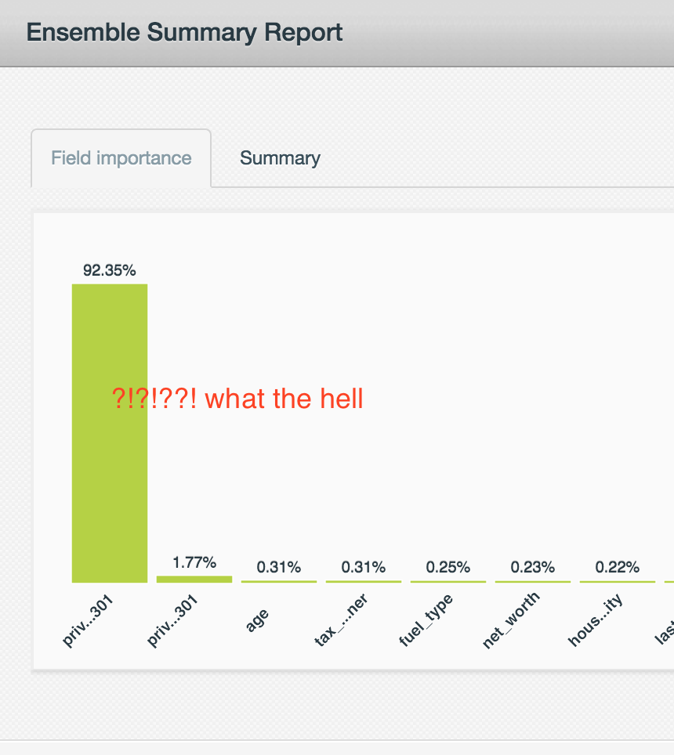
Watch for cheating
Domain expertise
If predicting solar customer, cheating based on tax incentives in property data?
Map it out
All goods in one area, all bads in another?
Notes:
Paranoia is so important.

Slide 29
Automate workflow
How do I make predictions in production?
Automate or die

Slide 30
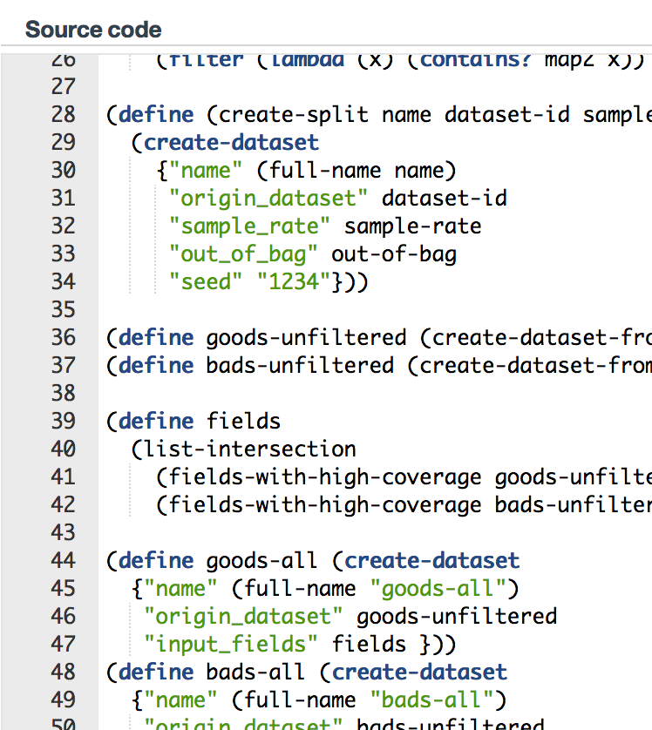
Automate workflow
BigML provides WhizzML
Make the hard network / scaling go away
Before
Polling HTTP
After
Single script

Slide 31
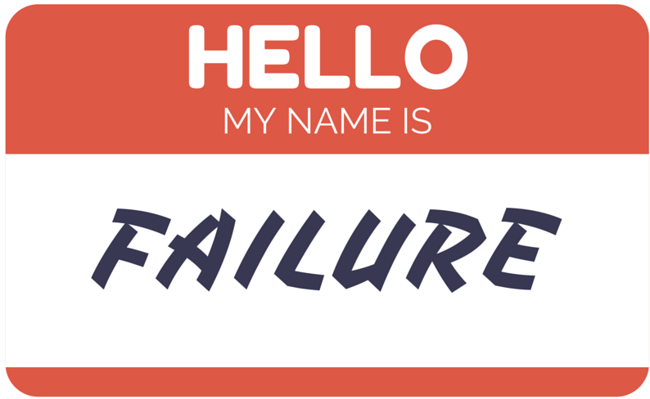
Concerns for the future

Slide 32

Convolutional / deep / ❓ neural nets
All of the exciting announcements are about neural networks
When are you limited by your choice of algorithm?

Slide 33
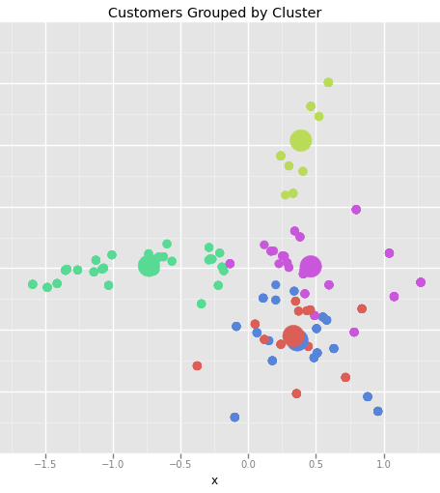
Beyond classification
There’s more to AI than just classification
What if we could do more with less?
Notes:
Understanding the tools may become more crucial. Can’t just focus on the data

Slide 34
What do I worry about?
Tool experts?
or
Domain experts?

